Slide 1
Social Media Analytics with GoodData
Alina Bashun
February, 2015

Slide 2
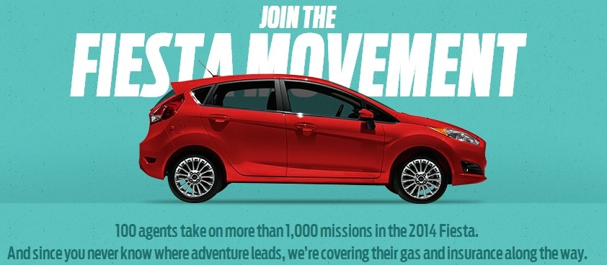
Ford’s Social Media
Notes:
First years after crisis were rough for automakers who were facing declining sales. Instead of launching a traditional ad campaign, Ford decided to simply hand over the keys of 100 Fiestas to 100 socially vibrant 20-smths for the ultimate 6 month test drive. In exchange for the free use of car, gas, insurance, agents were asked to tell the world about their life with their new Fiesta through social media. Each agent was given their own Twitter account, FB Page, YouTube channel, blog etc. Ford capitalized on social media ability to connect with a large number of individuals at a much lower cost than traditional media outlets. The use of social media allowed the message to spread exponentially. This allowed to gain access to completely untapped segment of the population.
As a result: 4 mln Twitter impressions, 17,885 FB fans, 7,350 Twitter followers, 50000 Fiesta info requests, 10000 cars sold in the first 6 days.

Slide 3
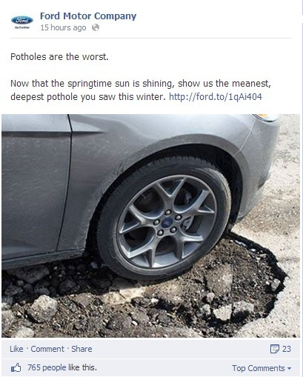
Social Media Conversations
Notes:
https://econsultancy.com/blog/64701-why-is-ford-s-social-media-strategy-so-good/

Slide 4

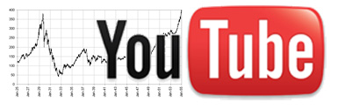



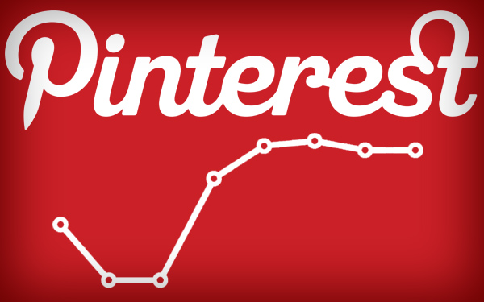
Almost every social network has it’s own native analytics.

Slide 5
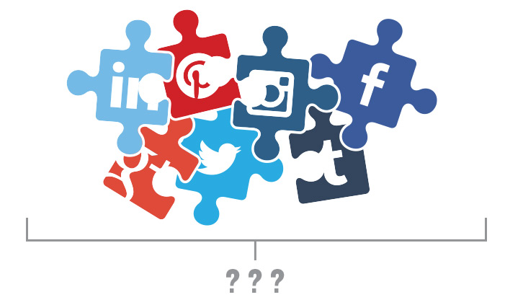
The problem is:
Cross-Channel Measurement
Notes:
http://simplymeasured.com/blog/2014/08/05/why-cross-channel-measurement-is-a-problem-for-social-marketers/

Slide 6
Why it’s important
Analyze global trends
Get insights about content performance
Find opportunities in each community
Optimize strategy and investments across networks

Slide 7
Key Facts
Different networks have APIs with different interface and different authentication mechanisms
Data sources API (e.g. Twitter, Facebook) may return different values for different API calls in time (some fixes in historical/fresh data on the data sources can occur)
Scalable multi-tenant solution

Slide 8
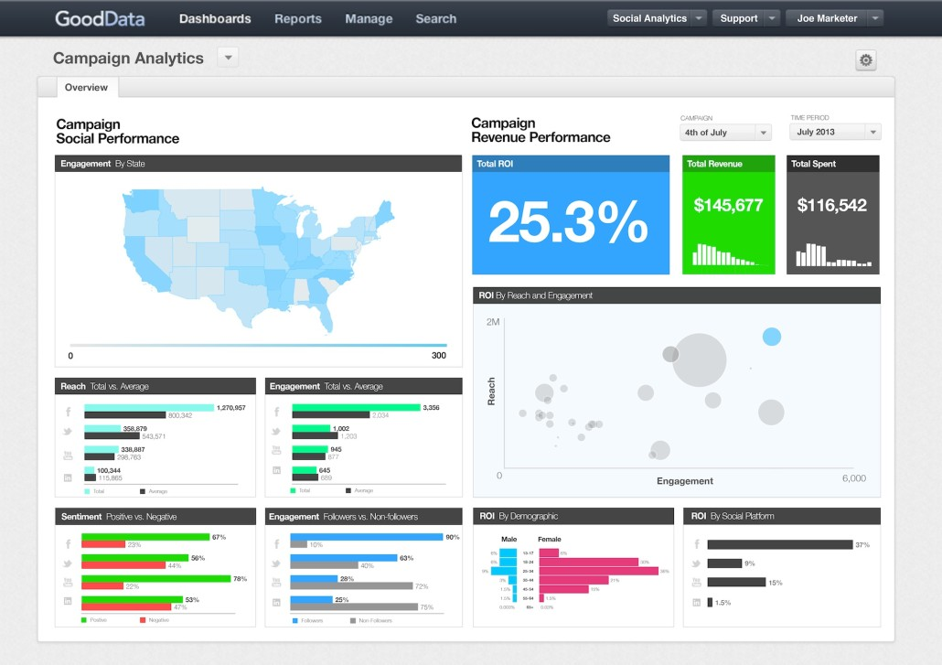
What is GoodData?
GoodData is a business analytics Platform as a Service (PaaS) that supports the entire lifecycle of data and analytics, from storage and data governance to data discovery.

Slide 9
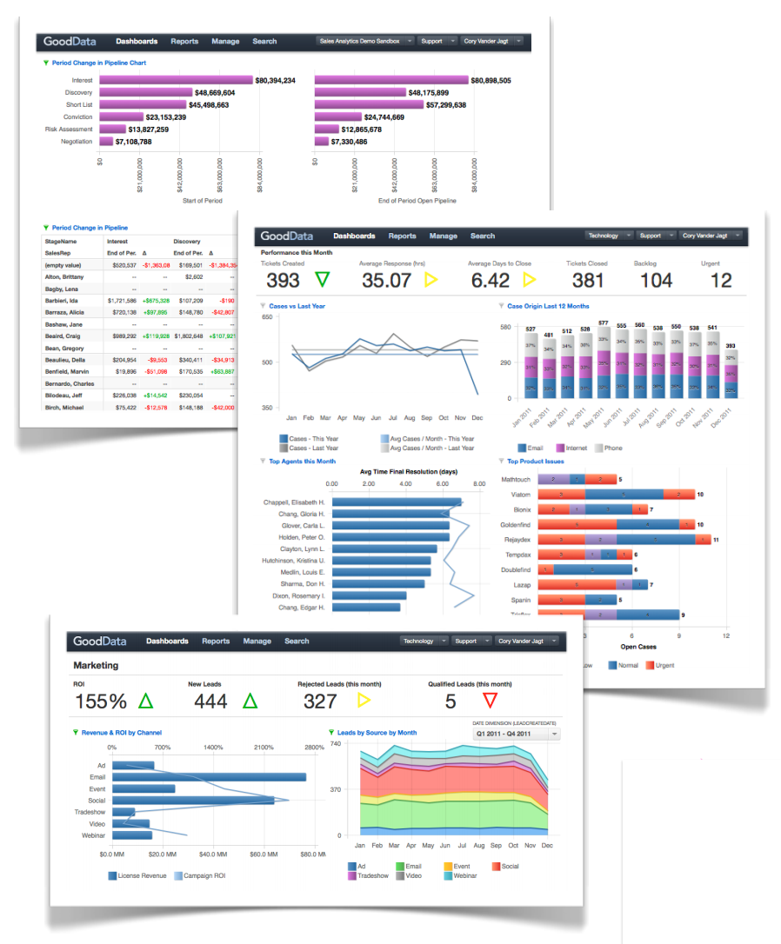
Solution Benefits
End-to-end cloud-based monetization platform built to scale
Connects business people with their business data silos
Operational dashboards, advanced analytics, data warehousing, integration – all as on-demand service
Allows ad hoc analysis / data discovery by non-technical users
https://university.gooddata.com

Slide 10
Architecture Principles
Multitenant
Service-based
All internal communications between services are managed through API calls, so GD Platform can be embedded as a set of services in other platforms
Scalability and Failover
Asynchronous load balancing among many instances of stateless services
Clustering and distributed processing for few (stateful) services
Notes:
http://help.gooddata.com/doc/public/wh/WHAll/Default.htm#PlatReqGuide/ArchitecturePrinciples.htm
The GoodData Platform is hosted in a multi-tenant environment, which enables superior sharing of resources across customers and is already scaled to service hundreds of thousands of customer projects. Instead of deploying a solution to an individual server, GoodData allows the sharing of hardware resources, as well as the services of the platform, and passes the cost savings to the customers.
By design, platform components with which the user interacts are abstracted from the rest of the platform, which enables continuous iteration and improvement on the underlying execution environment without requiring changes in customer data or projects. Examples:
Logical data model is separated from the physical data model. So, GoodData can continue to enhance and tune the physical data model, while maintaining the interface between the logical data model and physical data model. In this manner, data modelers can continue to iterate on the relationships of the data model without worrying about rebuilding the physical data model.
Abstracting the database interface allows GoodData to utilize the appropriate database for the underlying function. As a result, multiple types of databases have been deployed within the platform, and as needed, they can be swapped out if superior database solutions appear.
Key Benefit: The principle of abstracting user-defined data from the execution environment of the platform enables GoodData to constantly change and improve the underlying platform services without jeopardizing the data and metadata in customer projects. Migrations and upgrades are transparent to the customer, and new releases are deployed to customers without interruption.
Individual services are stateless, which means that they do not require information about the context in which they are executed.
As a result, a task from a single user can be routed to the least utilized instance of the service without any session or state constraints. This structure enables superior overall performance and resource allocation, and new instances of services can be initiated based on dynamic loads.
State information is maintained in the Distributed File System service and the centralized GoodData Computing Fabric, a brokering service that manages the deployment of work tasks to each of the hundreds of services within the platform.
Key Benefit: This centralization of service management in the GoodData Computing Fabric ensures that no single service can be a blocker; if an individual instance is bottlenecked, the GCF can initiate another instance to balance the load, dynamically shutting down service instances if the load is scaled back.
The GoodData Platform has been designed specifically for use in the business enterprise. Among other design features, the following ones support the functions of the business:
Application layer designed to meet the requirements of a functional area of a business and its users' reporting needs
Easy-to-use user interface for building reports hides complexities of relational database structures
Flexible data modeling enables ad-hoc dimensional analysis up and down the hierarchies of the data model
Key Benefit: In traditional MOLAP architectures, analysis is constrained by the dimensions predefined in a data cube. If a new dimension needs to be added, the entire cube must be rebuilt, often necessitating an overnight build cycle. In contrast, GoodData utilizes ROLAP technologies that do not require cubes. Clever caching techniques are used to pre-build aspects of the data hierarchy so that all users of a project can rapidly retrieve data.
The principle of abstraction reduces the administrative configuration for the platform to only user account management.
Business users can share and collaborate on the development of new reporting objects, including metrics, reports, and dashboards. Users can create discussion threads with the user interface and share or lock objects during development phases. Reports can also be generated via scheduled email for other stakeholders. The platform also supports HOLAP style analysis. It's possible for aggregates to be stored in a cube-like structure and transaction-level records in a relational datastore for drill-through functionality.
The base unit of the data architecture is the project, also known as a datamart. Customer projects are partitioned physically and logically.
In the above diagram, you can see that the project definition encapsulates the following data objects:
User information - users are invited to projects and assigned roles. User accounts are stored within the organization data object and are referenced in the project.
Project metadata - This set of data corresponds to the metrics, reports, and dashboards that users of the project define within the GoodData Portal.
Project data - All data that is loaded through ETL processes into the GoodData Platform is loaded into a specified project. As needed, a process can be used to load multiple projects.
Cached data - As queries are made from the project in the GoodData Portal, they are broken into smaller queries, which may be stored along with their retrieved data, within the project for faster retrieval by later queries executed by other project users.
Key Benefit: Since queries and results are stored in a cache available for the entire project, all project users benefit by increased usage of the reports in the project. As usage increases, performance of individual queries increases, too.
The project wrapper isolates the data and metadata of an individual project from other projects within the organization and across customers, utilizing strong security measures.

Slide 11
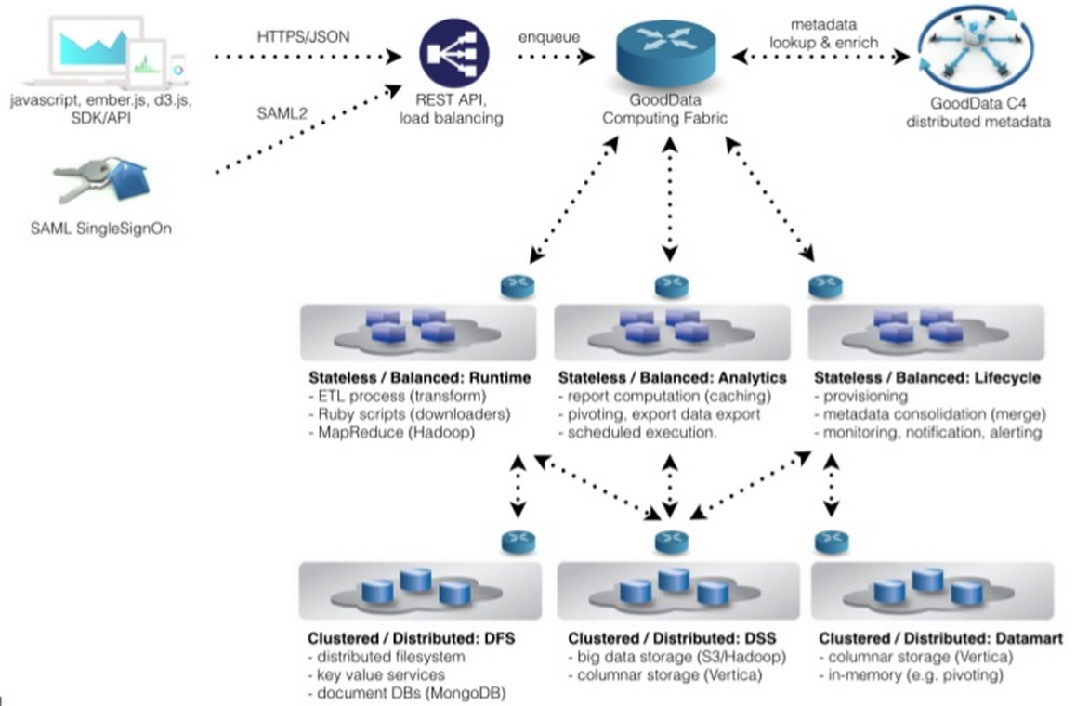
High Level Architecture

Slide 12
Tools
Notes:
https://developer.gooddata.com/tools

Slide 13
Building Projects
CloudConnect Designer
CloudConnect LDM Modeler
GoodData Portal
Agile Data Warehousing Service
Multi-Dimension Analytics Query Language (MAQL)
User-Specific Storage
Visualization SDK
Notes:
http://www.gooddata.com/press-releases/gooddata-launches-agile-data-warehousing-service
https://developer.gooddata.com/article/metrics-and-maql
https://developer.gooddata.com/article/user-specific-storage
http://sdk.gooddata.com/gooddata-js/

Slide 14
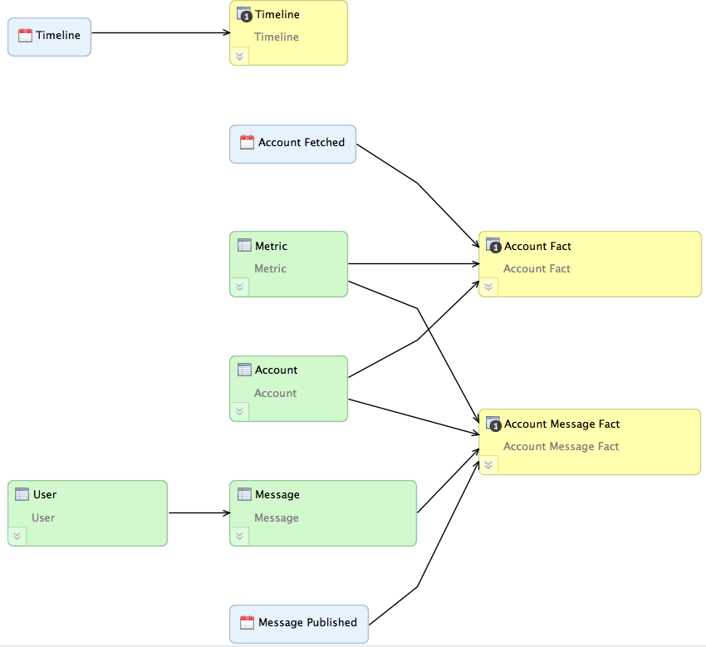
Sample Data Model

Slide 15
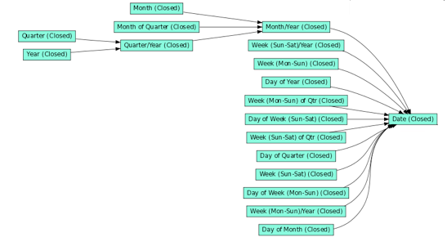
Date Dataset
Notes:
http://help.gooddata.com/doc/public/wh/WHAll/Default.htm#DISLDMModelerGuide/DefinitionOfDateDataset.htm

Slide 16
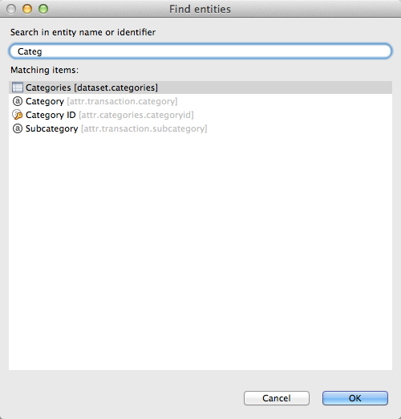
LDM Search
Notes:
http://help.gooddata.com/doc/public/wh/WHAll/Default.htm#DISLDMModelerGuide/SearchingtheDataModel.htm

Slide 17
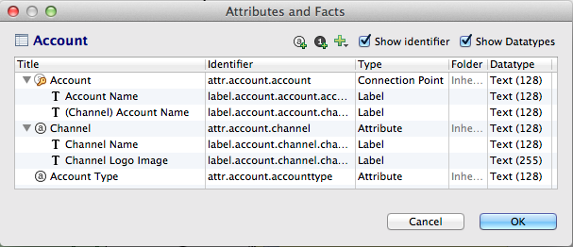
Dataset Editor
Notes:
http://help.gooddata.com/doc/public/wh/WHAll/Default.htm#DISLDMModelerGuide/AttributesAndFactsWindow.htm
Datatype only text() or decimal() for fact, int, bigint
You can add label/hyperlink to any of attributes

Slide 18
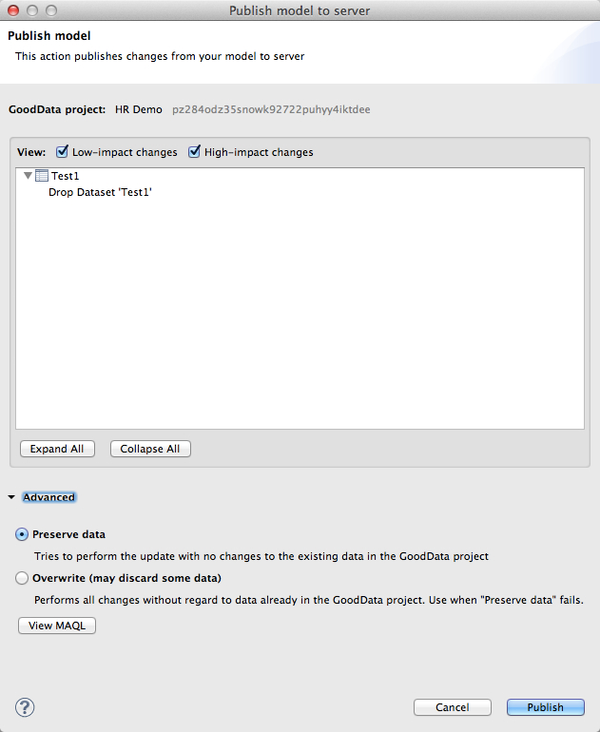
Model Deployment
Notes:
http://help.gooddata.com/doc/public/wh/WHAll/Default.htm#DISLDMModelerGuide/ManagingLDMProjectChanges.htm
Or you can view auto-generated MAQL script

Slide 19
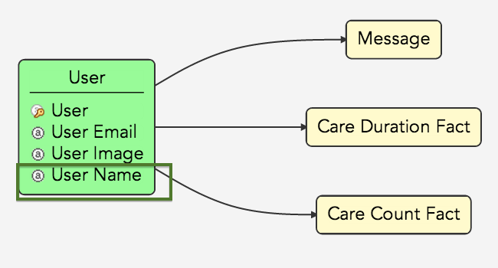
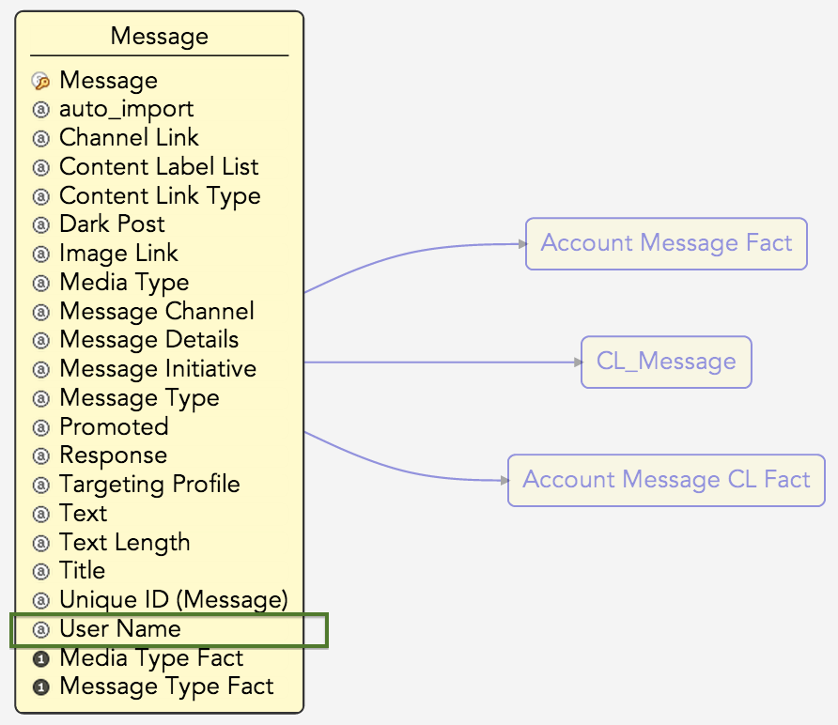
Fast Data Model Changes
Notes:
http://help.gooddata.com/doc/public/wh/WHAll/Default.htm#DISLDMModelerGuide/ImportantNoteAboutMovingAttributes.htm

Slide 20
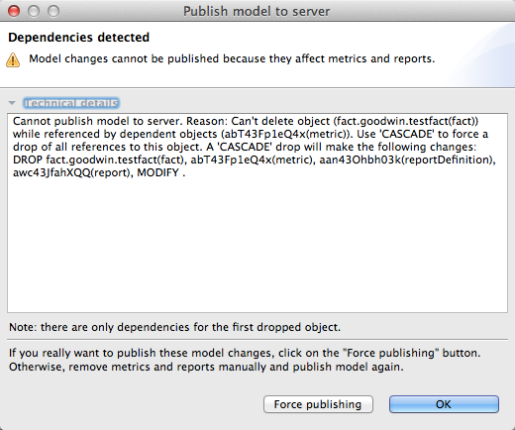
Object Dependencies
Notes:
http://help.gooddata.com/doc/public/wh/WHAll/Default.htm#DISLDMModelerGuide/ForcePublicationTechnicalDetails.htm

Slide 21
Data Modeling Tips
Avoid snowflake structures (normalized dimension tables)
Many-to-many challenge
Attribute data types vs. GD label data type
Attribute labels and their uniqueness
Reduce data volume
Minimize joins by denormalizing
Simplify reports multiple queries
Rollups
Notes:
http://help.gooddata.com/doc/public/wh/WHAll/Default.htm#DISLDMModelerGuide/RecommendedModelingPractices.htm

Slide 22
CloudConnect ETL
Based on the CloverETL Framework
Written in Java
Freeware
Streaming ETL
Visual UI
GoodData Adaptation
Rebranded
Added components
Readers for typical BI sources (e.g. SalesForce, Facebook)
Writers for Cloud-based storage components
Additional transformations
Usability enhancements
Notes:
CloudConnectprovidesagraphicalinterface for creation of ETL process steps

Slide 23
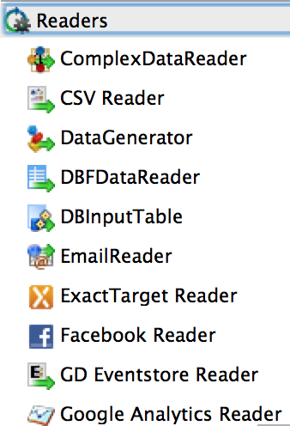
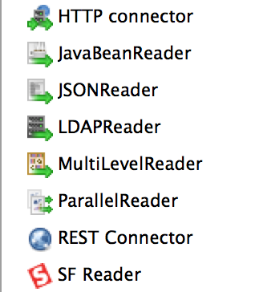
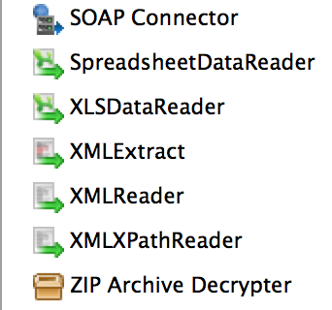
Accessing Data
Notes:
CloudConnecthasover25customizablereaders, including readers for:
▶ Local Files (e.g. CSV, XML, LDAP, Excel)
▶ Local Databases (e.g. Hadoop, JDBC)
▶ Web Sources (e.g. HTTP, JSON, SOAP, REST)
▶ Cloud Services (e.g. Facebook, Salesforce, Google Analytics)
Plus Others: Support various utility functions

Slide 24
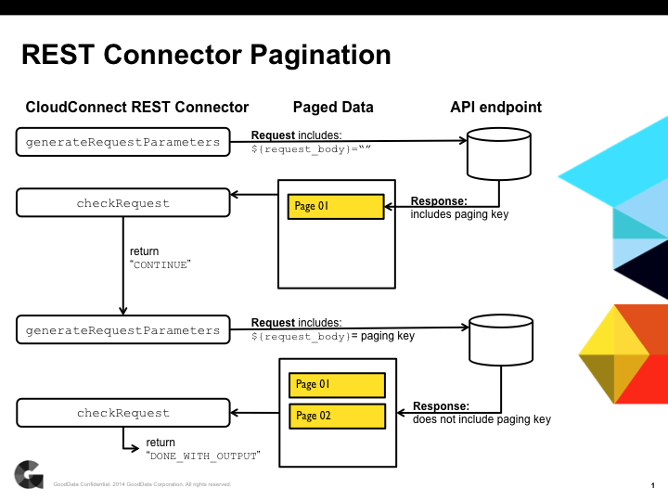
REST Connector Pagination
Notes:
https://developer.gooddata.com/article/paging-using-the-cloudconnect-rest-connector
Challenge: big amount of data coming from social network.
Approach: Use pagination to avoid memory overflow

Slide 25
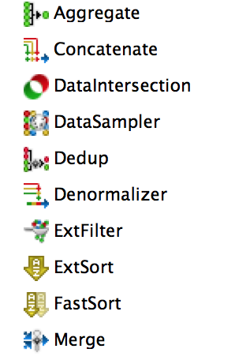
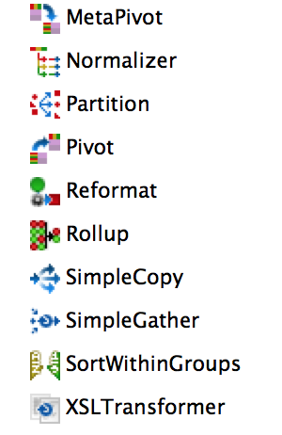
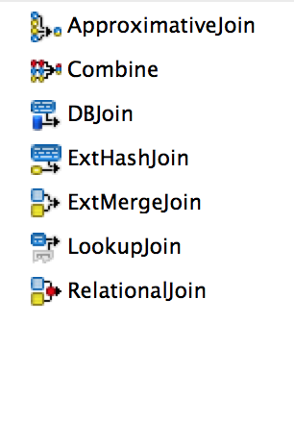
Transforming Data
Notes:
CloudConnecthasover25transformersfor:
▶ Reformatting
▶ Filtering
▶ Sorting
▶ Merging
▶ Lookups
▶ Joining
▶ And others...
▶ CTL2:
▶ Specialized scripting language
▶ Provides powerful customization capability

Slide 26
CC Transformation Language (CTL2)
Programming language included in CloudConnect
You can also write Java code if you prefer
Used for building complex expressions
Debugging filters
Transformations (available in most Transformers)
Documentation
Functions listed in Transform Editor
CloudConnect User Guide on https://developer.gooddata.com

Slide 27
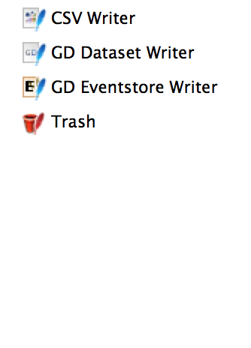
Writing (Loading) Data
The GD Dataset Writer Has 3 Modes:
Full load (replace all data with records from input): the default
Full load (purge all data when there is no input): use with caution
Incremental (append data from input)
Notes:
GoodDatahaswritersfor:
▶ CSV files (convenient for testing ETL flows)
▶ GD Datasets – the GD Writer uploads data directly to your cloud-based GoodData project
▶ Trash (useful for testing)

Slide 28
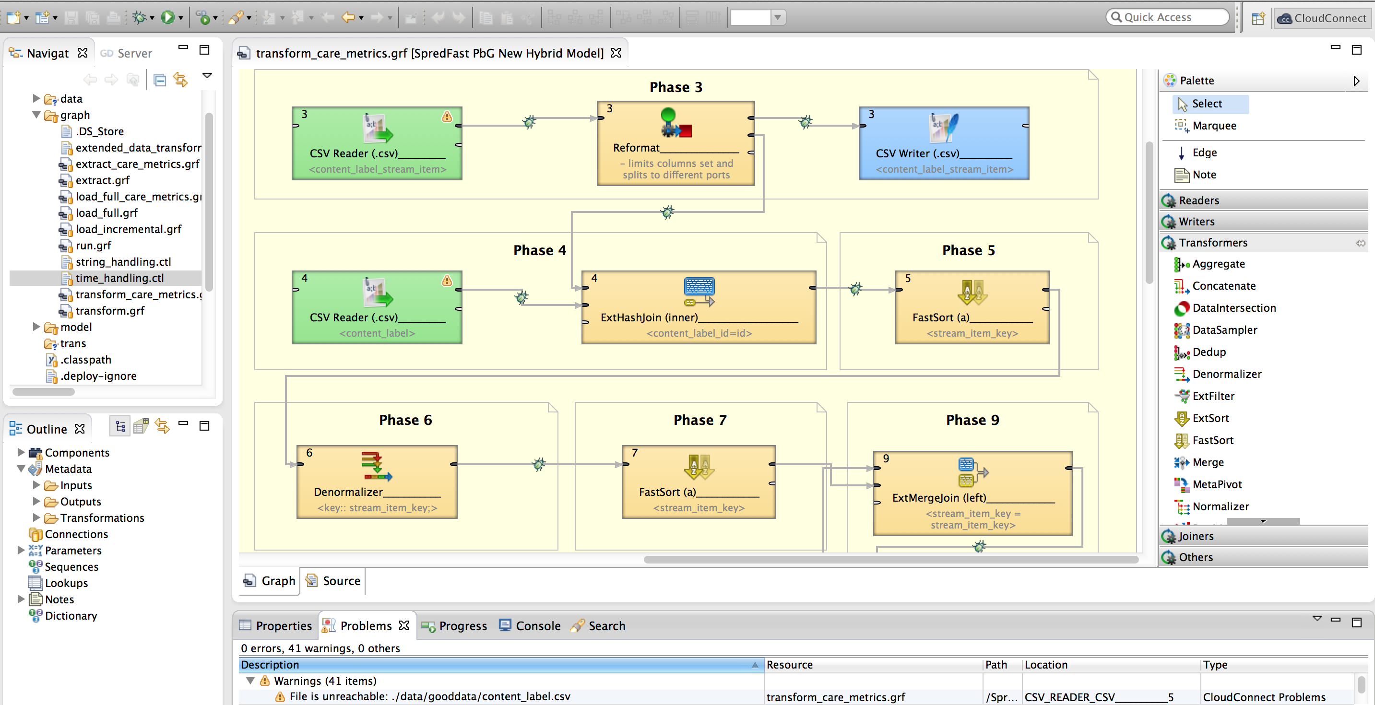
CloudConnect Studio

Slide 29
Maintaining Projects
Project-Specific Storage
CloudConnect Integration Console
GoodData Provisioning Scripts
Notes:
https://developer.gooddata.com/article/project-specific-storage
https://developer.gooddata.com/article/how-to-provision-gooddata-projects-programatically

Slide 30
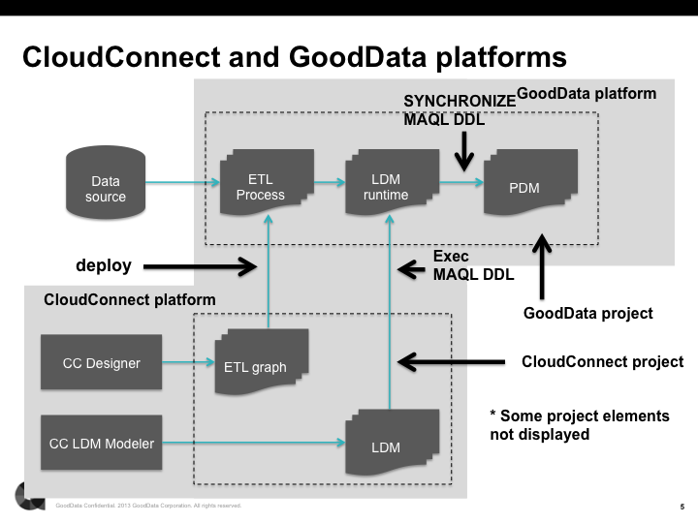
Project Structures
Notes:
http://help.gooddata.com/doc/public/wh/WHAll/Default.htm#DISLDMModelerGuide/ProjectStructures.htm
http://help.gooddata.com/doc/public/wh/WHAll/Default.htm#GettingStarted/GettingStartedwithCloudConnect.htm
After ETL graphs are deployed, we need to schedule, monitor and manage them.
In the diagram below, you can see the relationships between the CloudConnect and GoodData Platforms and how objects that you author in CloudConnect are published and integrated into the GoodData Platform.
Through the CloudConnect platform, you build and publish CloudConnect projects. These projects contain the ETL graphs and logical data model for your GoodData projects and are authored in the CloudConnect Designer and LDM Modeler components of CloudConnect, respectively.
l WhenyouarefinishedbuildingyourCloudConnectproject,youassociateit with a GoodData project and then publish it to that project for use. During publication, the MAQL DDL statements that are visible in the MAQL tab of the CloudConnect Designer are executed within the GoodData Platform to build the runtime version of the LDM.
l The final step of the MAQL DDL script is to synchronize the updated LDM with the physical data model. This step makes the necessary changes to the PDM to synchronize it with the updated version of the LDM, including the removal of any data and metadata that is in conflict with the changes.
l WhenanETLgraphispublishedtotheGoodDataPlatform,itmustbe associated with a schedule and possibly other graphs and their schedules into an entity called a process. Through a web interface, you can define the schedules for the ETL graphs that have been loaded into your GoodData projects. See Data Integration Console User Manual (PDF).
l Created through the GoodData Portal, GoodData projects contain the metrics, reports, and dashboards that rely on the data that is supplied based on the objects you define in your CloudConnect projects. These components are not represented in the above diagram.

Slide 31
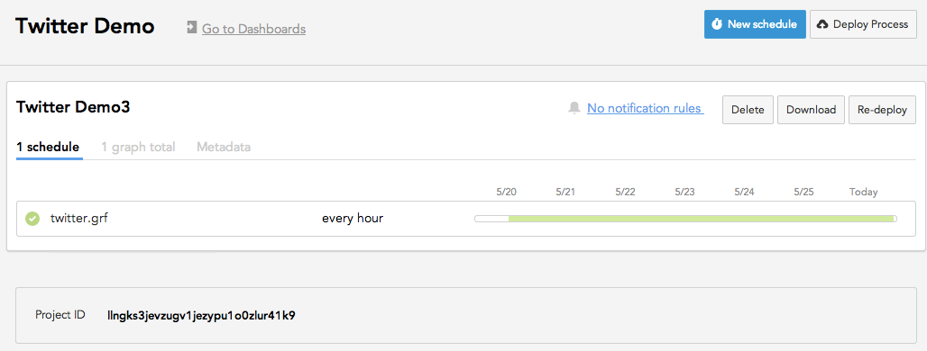
Data Integration Console
Manage multiple processes across multiple projects
Schedule, postpone and trigger ETL processes
Setup and receive notifications related to ETL processes
Monitor successful or failed ETL processes
Review logs generated during execution time
Review historical performance of ETL processes
Notes:
http://help.gooddata.com/doc/public/wh/WHAll/Default.htm#DICUserManual/DISC-ProjectDetailsScreen.htm

Slide 32
Platform Interfaces
GoodData REST APIs
Automation SDK
Gray Pages
GoodData Extension Tool for Chrome
CL Tool

Slide 33
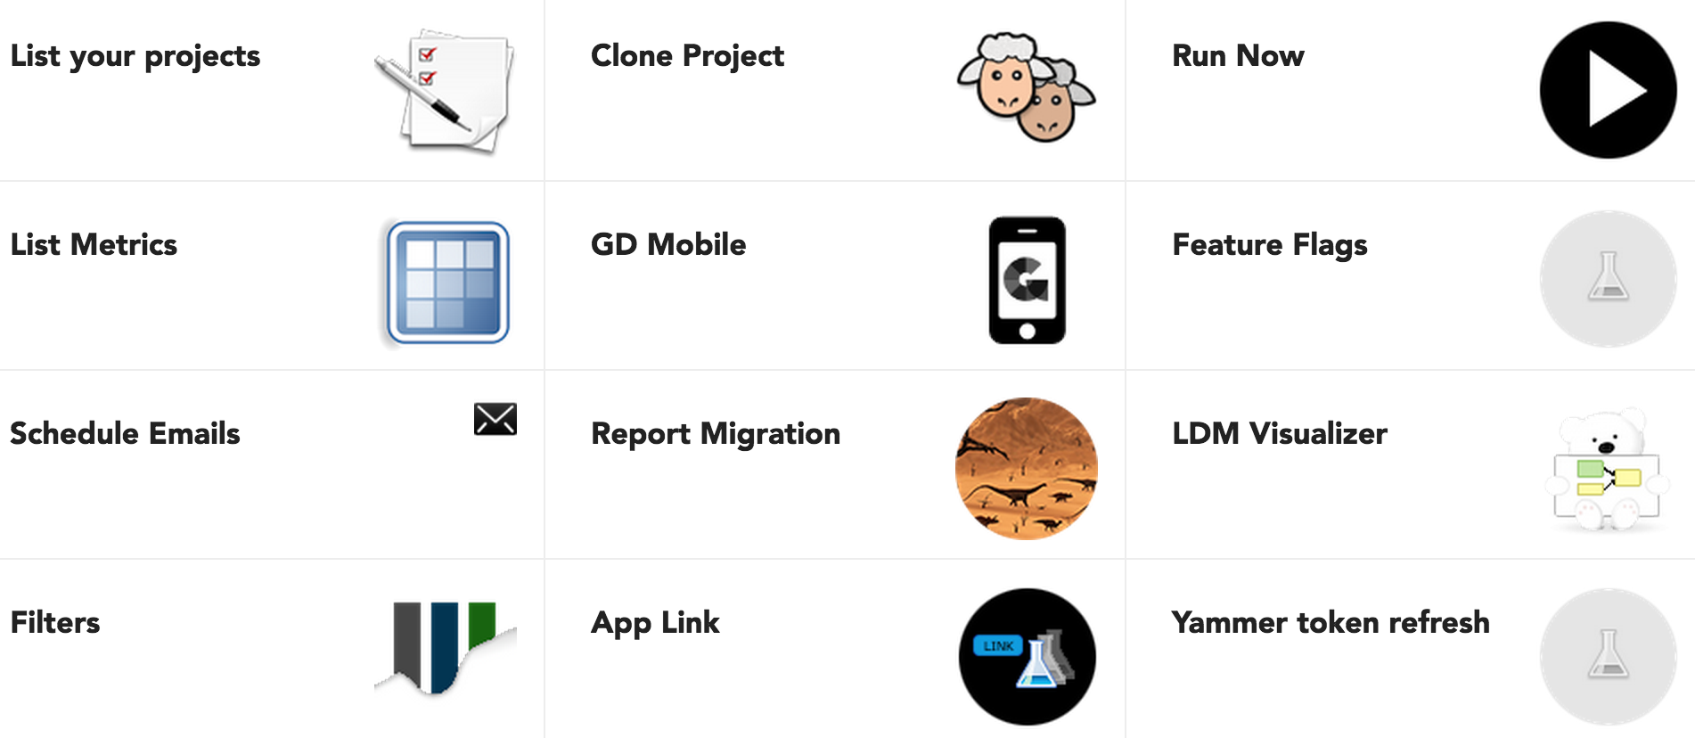
GoodData Labs Launchpad
Notes:
https://developer.gooddata.com/blog/introducing-gooddata-labs
GD Labs is a dashboard that presents all the applications, tools, automation workflows etc. in one place. It uses only public API to access the platform functionality. Currently its repository is open to all GD employees. Each app can be a simple javascript/jQuery application or more advanced Ember.js app.

Slide 34
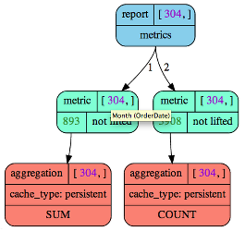
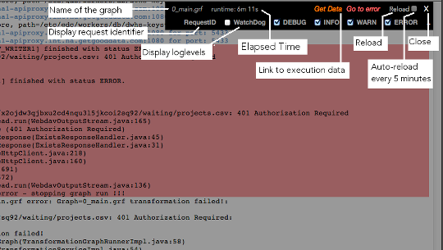
GD Extension Tool
Notes:
https://developer.gooddata.com/article/gooddata-extension-tool-for-chrome
http://developer.gooddata.com/blog/advanced-report-definition-tools

Slide 35
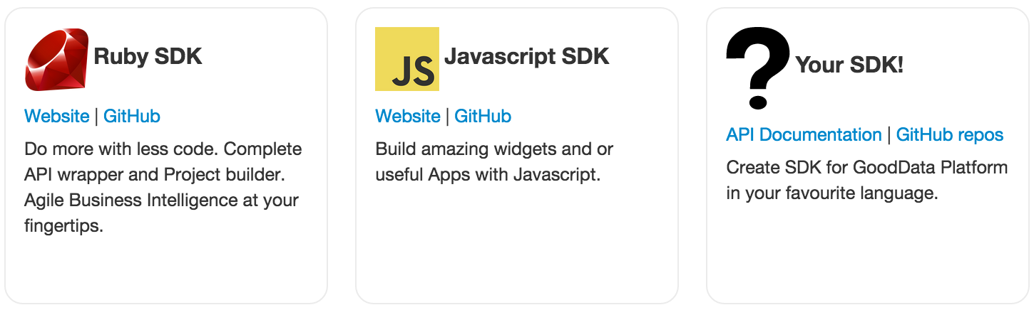
GoodData Open SDKs
Notes:
Tell about our SDK with CloudConnect

Slide 36

Generating new project
Performing operations on multiple projects
Creating/updating a data model
Looking around the project (examine number of users, facts, or attributes, numbers of stars in the model, number of lines in datasets)
Testing reports
Loading data
Computing reports, measuring reports execution time etc.
Notes:
http://developer.gooddata.com/ruby-cookbook#_connecting_to_different_server

Slide 37
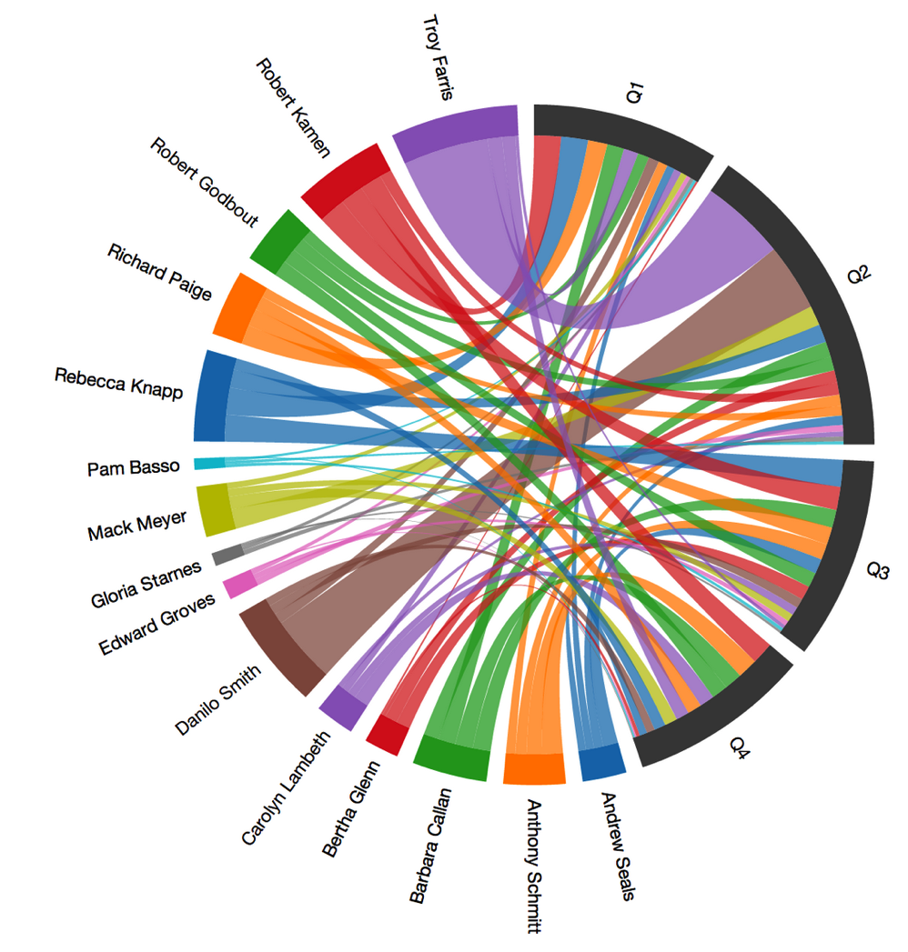
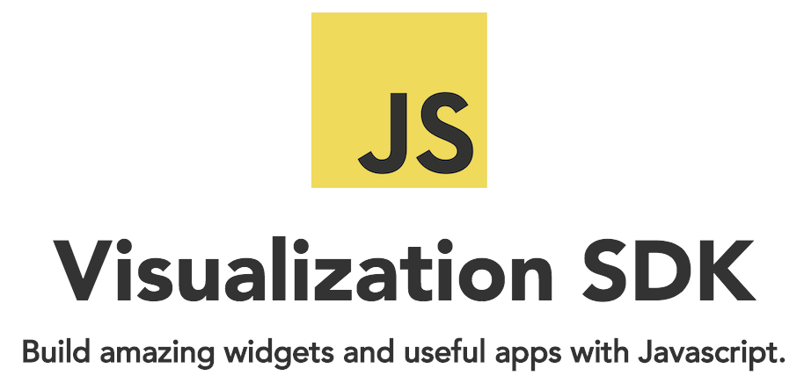
Notes:
Visualization SDK helps you to integrate your GoodData dashboards with libraries like D3.js to create your own unique visualizations and widgets that could be built in GD dashboard as web content.

Slide 38
Real-Life Challenges
Done:
Minimize data processing time
A lot of media content on social networks
In Progress:
Lack of out of the box automation to track changes in projects
To Do:
Incremental ETL with changing facts (full-load ETL need to process near 8TB of data for last 8 months)
Notes:
Challenge: Image/video thumbnail should be shown in the list of messages.
Approach: Use “Thumbnailator” (http://projects.coobird.net/thumbnailator/) to create thumbnail for images. For video – social network APIs provide information about published video including thumbnail. To get this information message import is scheduled to get this information. When exiting message is imported information about it is updated in database.
Note: All thumbnails are uploaded to Amazon S3 and URL of uploaded image is saved into database

Slide 39
Reference List
http://help.gooddata.com
http://developer.gooddata.com
http://www.slideshare.net/GoodData
https://econsultancy.com/blog/64701-why-is-ford-s-social-media-strategy-so-good/

Slide 40
Thank you!

